Slide 1
Mutable Data in Hive’s Immutable World
Lester Martin – Hortonworks 2015 Hadoop Summit

Slide 2
Connection before Content
Lester Martin – Hortonworks Professional Services
lmartin@hortonworks.com || lester.martin@gmail.com
http://lester.website (links to blog, twitter,
github, LI, FB, etc)

Slide 3
“Traditional” Hadoop Data
Time-Series Immutable (TSI) Data – Hive’s sweet spot
Going beyond web logs to more exotic data such as:
Vehicle sensors (ground, air, above/below water – space!)
Patient data (to include the atmosphere around them)
Smart phone/watch (TONS of info)
SOURCES
Clickstream | Web & Social | Geolocation | Sensor & Machine | Server Logs | Unstructured

Slide 4
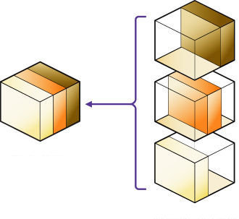
Good TSI Solutions Exist
Hive partitions
Store as much as you want
Only read the files you need
Hive Streaming Data Ingest from Flume or Storm
Sqoop’s –-incremental mode of append
Use appropriate –-check-column
“Saved Job” remembering –last-value

Slide 5
Use Case for an Active Archive
Evolving Domain Data – Hive likes immutable data
Need exact copy of mutating tables refreshed periodically
Structural replica of multiple RDBMS tables
The data in these tables are being updated
Don’t need every change; just “as of” content
SOURCES
ERP
CRM
SCM
eComm
Existing Systems

Slide 6
Start With a Full Refresh Strategy
The epitome of the KISS principle
Ingest & load new data
Drop the existing table
Rename the newly created table
Surely not elegant, but solves the problem until the reload takes longer than the refresh period

Slide 7
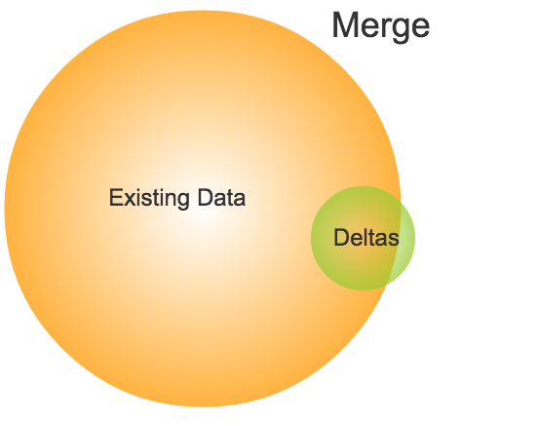
Then Evolve to a Merge & Replace Strategy
Typically, deltas are…
Small % of existing data
Plus, some totally new records
In practice, differences in sizes of circles is often much more pronounced
Notes:
This diagram shows the typical use case where the deltas represent a small percentage of the existing data as well as the addition of some records that are only present in the delta dataset. In practice, the differences in size of these two circles would be much more pronounced as the existing data includes historical records that have not been modified in a long time and most likely will not be modified again.

Slide 8
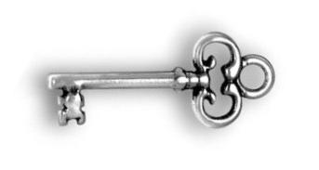
Requirements for Merge & Replace
An immutable unique key
To determine if an addition or a change
The source table’s (natural or surrogate) PK is perfect
A last-updated timestamp to find the deltas
Leverage Sqoop’s –-incremental mode of lastmodified to identify the deltas
Use appropriate –-check-column
“Saved Job” remembering –last-value
Notes:
If no last-updated timestamp is present, an alter table could create such a column and a combination of a DEFAULT value of current timestamp to have new records populate this and an “ON UPDATE” trigger could be created that takes care of updating the timestamp

Slide 9
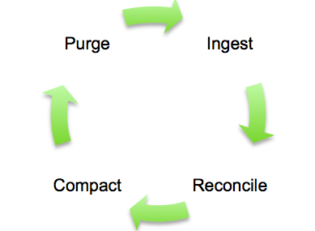
Processing Steps for Merge & Replace
Ingest – bring over the incremental data
Reconcile – perform the merge
Compact – replace the existing data with the newly merged content
Purge – cleanup & prepare to repeat
See blog at http://hortonworks.com/blog/four-step-strategy-incremental-updates-hive/, but note that merge can be done in multiple technologies, not just Hive
Notes:
You can use other tools than just Hive, such as Pig, to perform these operations.
Pig approach could be:
Ingest the data (like above)
In single Pig script; read old & new, merge them, load into “resolved” table
Drop old table, rename new table, and recreate “resolved” table (for next run)

Slide 10
Full Merge & Replace Will NOT Scale
The “elephant” eventually gets too big and merging it with the “mouse” takes too long!
Example: A Hive structure with 100 billion rows, but only 100,000 delta records
Notes:
When there is a small number of actual changes compared with a large number of unchanged records the incremental data ingest step brings limits the amount of data that needs to be transferred across the network as well as the amount of raw data that needs to be persisted in HDFS. There will be a point when the merging of a single delta file with a larger existing records file will take longer than just getting the full copy, or at least, the merge & replace processing will be too lengthy to be useful.
An example of this could be a model where the existing data size is around 100 billion, but there are only 100,000 delta records.

Slide 11
What Will? The Classic Hadoop Strategy!

Slide 12
But… One Size Does NOT Fit All…
Not everything is “big” – in fact, most operational apps’ tables are NOT too big for a simple Full Refresh
Divide & Conquer requires additional per-table research to ensure the best partitioning strategy is decided upon
Notes:
The classic 80/20 rules applies (maybe even 95/5) for table that don’t/do need partitioning for benefit of the merge & replace strategy.
In fact, nothing would be prevent a table that uses Full Refresh or comprehensive Merge & Replace from having partitions.

Slide 13
Criteria for Active Archive Partition Values
Non-nullable & immutable
Ensures sliding scale growth with new records generally creating new partitions
Supports delta records being skewed such that the percentage of partitions needing merge & replace operations is relatively small
Classic value is (still) “Date Created”
Notes:
Bad examples would include a building identifier or the city or zip code that buildings are located within. We could get a wide spread of the data, but delta records would likely cover most, if not all, of the partitions .

Slide 14
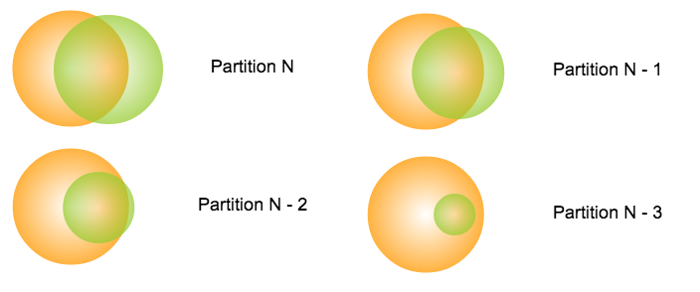
Work on (FEW!) Partitions in Parallel
Notes:
The goal is to break down the delta processing at the partition level and to be able to focus only on a subset of the overall partitions. In many ways, the processing is much like the basic merge & replace approach, but that several, much smaller, iterations will occur while leaving the mass majority of the partitions alone.

Slide 15
Partition-Level Merge & Replace Steps
Generate the delta file
Create list of affected partitions
Perform merge & replace operations for affected partitions
Filter the delta file for the current partition
Load the Hive table’s current partition
Merge the two datasets
Delete the existing partition
Recreate the partition with the merged content

Slide 16
Interested in the Rest of this deck?
Then check out the following links for the slides and video
- http://www.slideshare.net/Hadoop_Summit/mutable-data-in-hives-immutable-world-49979357
- https://www.youtube.com/watch?v=EUz6Pu1lBHQ
Notes:
We’ll go VERY FAST through this during the presentation, but will be useful to review later.

