Slide 1
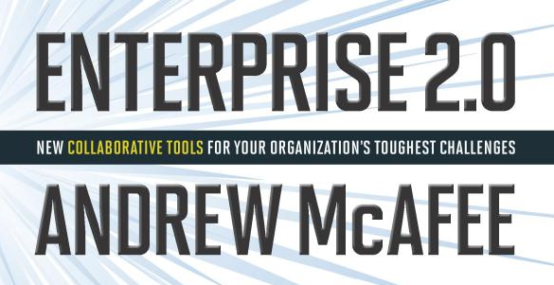
Review of Enterprise 2.0
Book by: Andrew McAfee
Review by: Lester Martin

Slide 2
Why Use Collaboration Tools?
“With enough eyeballs all bugs are shallow” – Eric Raymond
Theme of James Surowiecki’s The Wisdom of Crowds is a powerful & novel message that it is often possible to harness the “collective intelligence” of a group of people and thus yield better or more accurate information than any individual within the group possesses. This is an about-face from the fear of groups:
Yielding the “lowest common denominator” of their members’ contributions
Turning into mobs that actually behave less intelligently than any of their members

Slide 3
First Focused Attempts at Computer-Supported Collaboration
Groupware such as Lotus Notes & Exchange/Outlook
Yielded solid benefits in messaging and calendaring
Less suited for finding and sharing information and knowledge
Knowledge Management (KM)
Simply did not reach the level of acceptance that was anticipated
What has persevered is:
Information produced via email, texting and IM, but they are for 1:1 or 1:M communications (i.e. Channels)
Information consumed via intranet and web sites created/maintained by only a few people, not by all members of a workgroup

Slide 4
Trend: Free and Easy Platforms for Communication/Interaction
Messaging via Channels keeps communication private
NOTE: Sometimes this is exactly what is wanted/needed
Platforms desired over Channels where:
Contributions are globally visible
Persistent (to include URL) & Versioned
NOTE: Security can be applied as needed
Incredible ease to author a wiki page or create a blog entry
Rich WYSIWYG editors
In-stream visualization packages
Clipboard integration with media formats

Slide 5
Trend: A Lack of Imposed Structure
Structure = Workflows, Decision Rights, Interdependencies and Information (centralized formatting, relationships, relevance, etc)
The norm has been to use technology to impose structure for
ERP, CRM, SCM and other “enterprise systems”
This does make sense in MANY situations, but not ALL
Even Wikipedia (initially Nupedia) started with a 7-stage process, but 18 months later only had 12 articles
Incredible growth (see next slide) when stood up a peer site based on wiki technology (i.e. the Wikipedia we know today)

Slide 6
Trend: A Lack of Imposed Structure (cont)
Wikipedia growth when Structure was discarded
Notes:
617 articles by end of January
March saw 2,221 articles
July had 7,243
EOY 2001 Wikipedia had over 19,000
Mid-2008 had 2.4 million article in English and more than 500K each in German, Polish and French with more than 250K in each of six other languages.
Today (late 2012), Wikipedia has over 4 million English articles

Slide 7
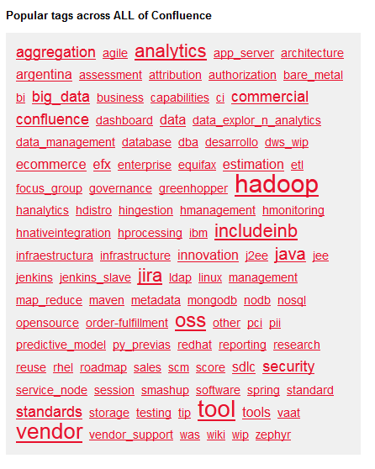
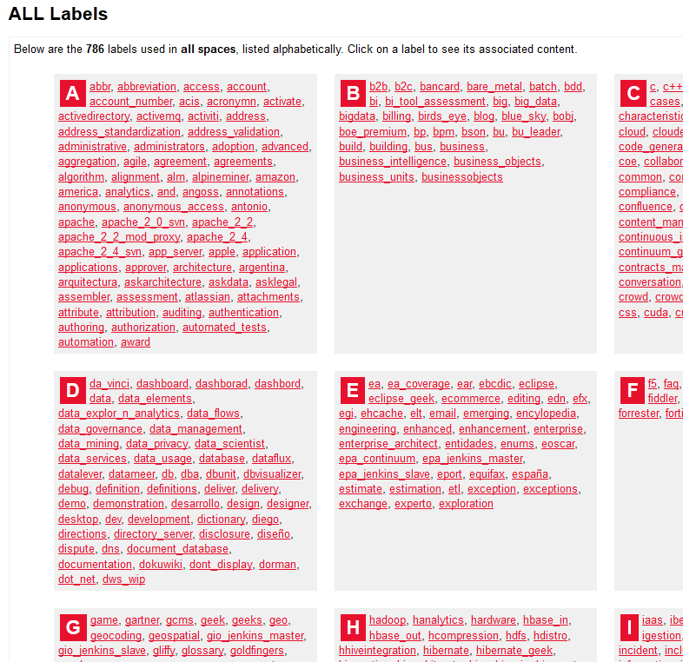
Trend: A Lack of Imposed Structure (cont)
Human-created taxonomy couldn’t keep up and was replaced by FOLKSONOMY
Categorization developed over time by folks
An alternative to taxonomy which is a categorization developed at a single point in time by an authority
Popularly surfaced as labels & tag clouds

Slide 8
Trend: Mechanisms to Let Structure Emerge
Web page citing each other drives popularity & relevance
Google’s PageRank algorithm (pages are a community, not a collection)
The emergent nature (emergence = appearance of global structure as the result of local interactions) based on these refs
Usually not present in intranets (emergence needs large numbers of actors and interactions) as typically produced by a few people (though passively consumed by many) and most pages are heavily interlinked
Tagging; conducted by many agents spread around a Platform
Acting independently with great autonomy (no predefined tags)
Acting in their own self-interest (surfaces existing content & interests)

Slide 9
Emergent Social Software Platforms (ESSPs)
ESSPs rely on SLATES
Search; have to be able to find things
Links; interlinking drives popularity & relevance
Authoring; content is constantly created, updated & interlinked by many
Tags; collectively creates the folksonomy
Extensions; using algorithms to say, “if you liked that, then by extension you’ll like this” (driving by voting, rating, liking, commenting, etc)
Signals; leverage tools like configurable activity streams, RSS and email to help us to not get overwhelmed or lose out

Slide 10
Tie Strength and Mark Granovetter’s The Strength of Weak Ties (SWT)
Well… this is a WHOLE other sociology talk, but we want to:
Enhance existing strong ties
Strengthen weak ties
Convert potential ones
Interact w/strangers
None
Potential
Weak
Strong
Ties

Slide 11
Core Principles of Collaboration
Principles practiced on Intelligence Community’s Intellipedia
Work at the Broadest Possible Audience
The Ask: Move content from our personal and/or team-level protected stores to allow this content to be owned and refined by the masses
Work Topically, Not Organizationally
The Ask: For users and teams to be vigilant in determining if the content they are authoring is appropriately scoped
Replace Existing Processes
The Ask: Challenge ourselves to be more productive in collaborating
NOTE: This introduces a level of transparency & crowdsourcing that is radically different to what most knowledge workers are used to

Slide 12
Benefits of ESSPs
Group Editing
Authoring
Broadcast Search
Network Formation and Maintenance
Collective Intelligence
Self-Organization

Slide 13
Roadmap for Success
Turning Off the Old
Using Believers
Designing Technologies that Will Be Used
Six Organizational Strategies
Determine desired results, then deploy appropriate ESSPs
Prepare for the long haul
Communicate, educate and evangelize
Move ESSPs into the flow
Measure progress, not ROI
Show that using ESSPs is valued

Slide 14
Summary of Enterprise 2.0
Affirmation of what many of us already know, but brings some formality to the topic
Suggested for those organizations who have not already internally advocated wikis and blogs
Made it to Lester’s permanent bookshelf!! << that’s my endorsement!
Available at Amazon in Kindle or hardcover editions
SO… GO BUY IT!

