Slide 1
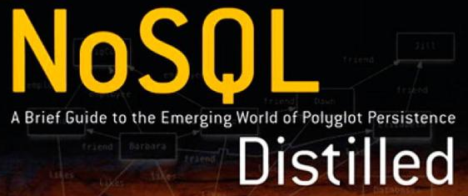
Review of NoSQL Distilled
Book by: Pramodkumar J Sadalage & Martin Fowler
Review by: Lester Martin

Slide 2
What’s Wrong with SQL?
Nothing Really!!
RDBMS technologies are VERY mature and the backbone of most systems today
ACID benefits counted on by OLTP systems
Transactions spanning multiple DML statements (distributed txns w/2PC, too!)
Can be an integration technology all by itself (yes… “data integration” does pain an OO developer like myself, but it is a reality that is being leveraged every single day)
Great for well-understood and normalized data models
But…
The impedance mismatch between in-memory object graphs is always there
Cannot scale (at least in a cost-effective manner) to LUDICROUS data
Thinking of the 3 V’s of Big Data; Variety, Velocity and Volume
Example: capturing cell phone location data for 100M cell phones every 10 seconds would yield almost 1T records/day

Slide 3
What is NoSQL?
Generic name for persistence stores with these common characteristics
Not using the relational model
Running well on clusters
Open-source
Built for the 21st century web estates
Schemaless
(usually) No transactioning beyond single operation
Cements the concept of Polygot Persistence
Today we see relational databases as one option for data storage
With many (evolving) NoSQL types and implementations solving different use cases we will evolve to an approach of using different data stores with the same application
We’ll visit this again!

Slide 4
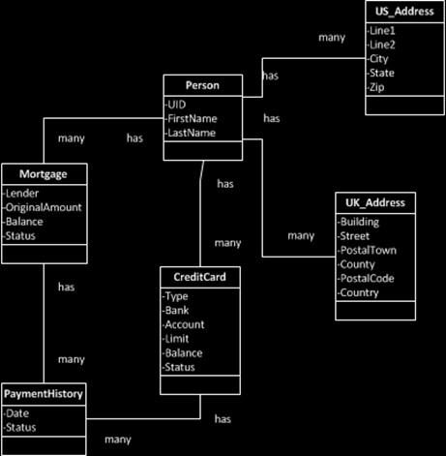
Relational Data Models
RDBMS data models are visualized via Entity Relationship Diagrams as well as physical DDL
Elements of the bigger whole are stored independently in tables with relational constraints (such as foreign keys) identifying the relationships
This design is aggregate-ignorant

Slide 5
Aggregate Data Models
An aggregate is a collection of related objects treated as a single unit
It is physically stored in this format – data and model definition together
Becomes painful when there are many ways to retrieve the same/similar data
Transactions occur at the aggregate level (addresses most of the txn’ing concerns)
{
"Person" : {
"FirstName" : "Fred",
"LastName" : "Flintstone"
},
"Addresses" : [
{ "Address":
{ "Country":"USA",
"Original":{ "raw":"10 Rubble Blvd. Bedrock, NJ 03241"},
"Standardized":{"StreetNumber":"10",
"StreetName":"RUBBLE",
"StreetSuffix":"BLVD",
"City":"BEDROCK",
"State":"NJ",
"ZipCode":"03241"},
"Cleansed":{ "StreetNumber":"10",
"StreetName":"RUBBLE",
"StreetSuffix":"BLVD",
"City":"BEDROCK",
"State":"NJ",
"ZipCode":"03241"}
}
}
],
"LinesOfCredit" : {
"CreditCards" : [
{ "Type":"VISA",
"Bank":"BOA",
"Account":"V1234",
"Limit":4000.00,
"Balance":1205.32,
"PaymentHistory":[
{"0109":1},
{"0209":0},
{"0309":-1}
],
"Status":"OPEN"
},
{ "Type":"MC",
"Bank":"Chase",
"Account":"MC4567",
"Limit":5000.00,
"Balance":4321.12,
"PaymentHistory":[
{"0111":1},
{"0211":0},
{"0311":1},
{"0411":1},
{"0511":1},
{"0611":1},
{"0711":1},
{"0811":1},
{"0911":-1}
],
"Status":"OPEN"
}
],
"Mortgages" : [
{ "Bank":"...",
"Account":"...",
"OriginalAmount":"...",
"CurrentBalance":"...",
"PaymentHistory":[
{"0109":1},
{"0209":0},
{"0309":-1}
]
}
]
}
}
json.schema

Slide 6
Types of NoSQL Technologies
Key-Value Stores
Only able to look up data by the Key
Value is essentially a CLOB/BLOB (any format)
Document Databases
Data is stored in self-describing, hierarchical tree data structures which can consist of maps, collections and primitive values (utilizing XML or JSON/BSON)
Searchable by any element of the aggregate and supports indexing
Column-Family Stores
Essentially a key-value store where the Value is a “map of maps” (no constraints on how data values are formatted)
Graph Databases
Something entirely different than the others in almost every way
Stores small records (nodes) with directional relationships (edges)
Both, nodes and edges can have properties

Slide 7
Schemaless? Really?
Technically – YES
Logically (and Practically) – NO, or more appropriately NOT EXACTLY
Applications themselves have an implicit schema they are expecting
This flexibility enables faster development than with RDBMS schema mods
Similar structures can coexist (can also allow for gradual data migration)
You base your aggregate model on your data access, not to attain 3NF (this could mean data duplication)
Requires you to see the model’s implementation as an application database, not an integration database (encourages you to build a service layer)

Slide 8
Distribution Models
Sharding (aka partitioning)
“The secret ingredient in the web-scale sauce”
Storing different data on separate nodes; each handling their own read & write ops
Replication (for resiliency)
Copying data across multiple server so each bit of data can be found in multiple places
Combining Sharding & Replication
Of course… if you CAN work within a single server then do it!
Less complexity
Even better performance

Slide 9
CAP Theorem & Eventual Consistency
What kind of NoSQL talk would this be without these?
Worthy of a deep discussion all by itself, the CAP theorem in a nutshell states that you can pick two of the following characteristics
Consistency
(read & write) Availability
Partition tolerance
If you thought ACID was a catchy acronym, the NoSQL won’t disappoint as it gives us the opposite of ACID – BASE which stands for
Basically Available
Soft state
Eventual consistency

Slide 10
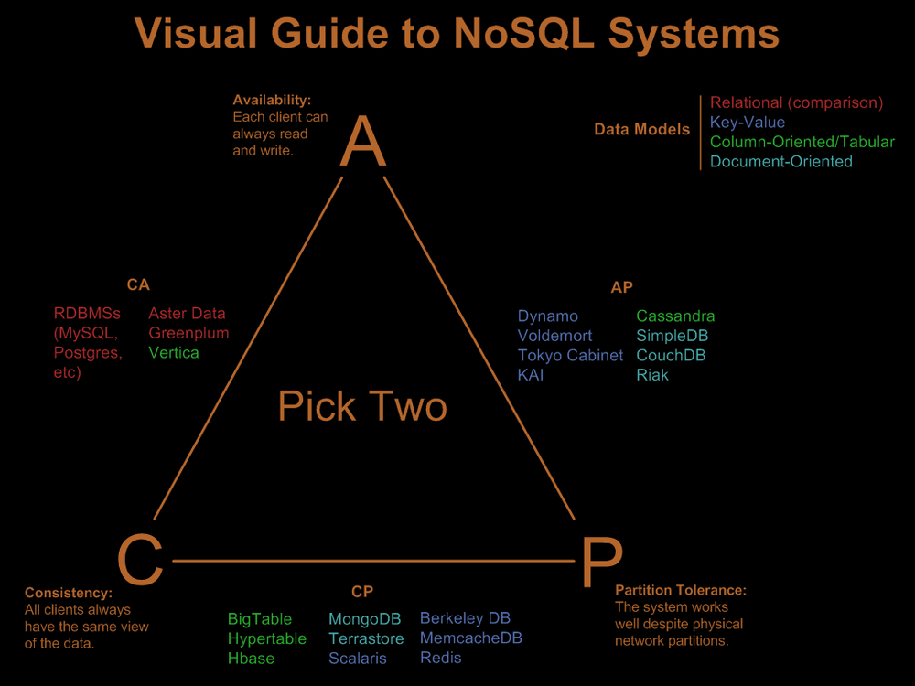
Visualizing CAP Theorem & BASE

Slide 11
Implementation Options
NoSQL Type | Popular Options
Key-Value | Riak, Redis, Memcached, Amazon DB, Project Voldemort
Document | MongoDB, CouchDB, Terrastore, OrientDB, RavenDB
Column-Family | Cassandra, HBase, Hypertable, Amazon Simple DB
Graph | Neo4J, Infinite Graph, OrientDB, FlockDB
Book includes dedicated chapters addressing each NoSQL type discussing features of
Consistency
Transactions
Availability
Query Features
Scaling
Also presents suitable use cases as well as guidance on when not to use a particular type
Embrace POLYGOT PERSISTENCE
Leverage the fact that different databases are designed to solve different problems

Slide 12
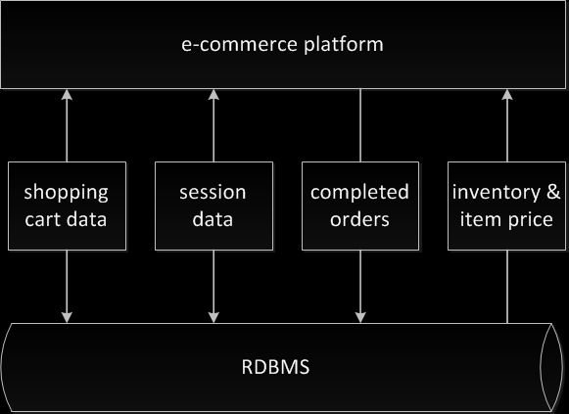
Today’s RDBMS Architecture…
Many enterprises tend to use the same database engine to store business transactions, session management data, and for other needs such as BI, reporting, logging, etc

Slide 13
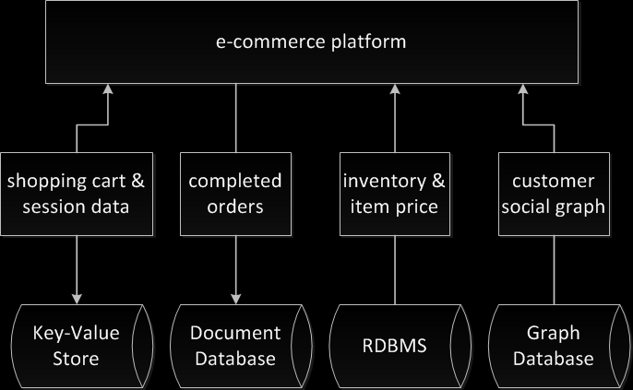
Can Become…
Example implementation of polygot persistence

Slide 14
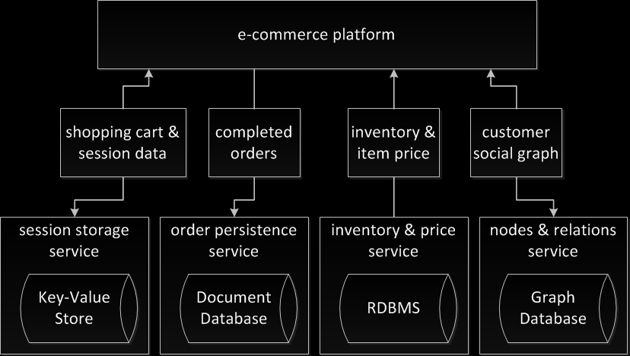
Or Be Even Better…
Example implementation of wrapping data stores into services

Slide 15
But, With Added Complexity & Cost...
Adding more data storage technologies increases complexity in programming and operations
Due to RDBMS maturity and the available pool of people with experience, many, if not most, projects using RDBMS should stick with the default
But… I want to use NoSQL!!
Find a true use case where the advantages outweigh the additional costs/complexity
Hedge your bets by wrapping a service layer around your application database

Slide 16
Summary of NoSQL Distilled
It’s short/n/sweet & to the point – you’ve got to appreciate that!!
Presents a quick overview of the NoSQL landscape ending with some pragmatic recommendations
Good book for those brand-new to NoSQL, but just a bit better for the person who has done some reading-oriented research and is ready to dive in head-first into these technologies

